Slide 1
“NLP Project for Disaster Tweet Classification”

Slide 2

Data Overview: Shape:→ 7613 rows (tweets) and 5 columns.
Columns: Id: Unique identifier for each tweet. keyword: Disaster-related keyword (e.g., earthquake, fire, flood) – sometimes missing. location: Free-text user location – often missing or noisy. Text: Raw tweet content. target: Binary label (0 = Not Disaster, 1 = Disaster).

Slide 3
Cleaning Tweets: Tweets are full of noise: links, mentions, hashtags, special characters, etc.Created a function → Clean_tweet() to make the text suitable for Natural Language Processing (NLP). Remove URLs Remove Mentions Convert to lowercase Remove extra spaces Handle hashtags Keep only alphabetic characters
Result: Original: "Breaking! Huge #earthquake in LA! Stay safe @friends. http://news.com" Cleaned: "breaking huge earthquake in la stay safe"

Slide 4
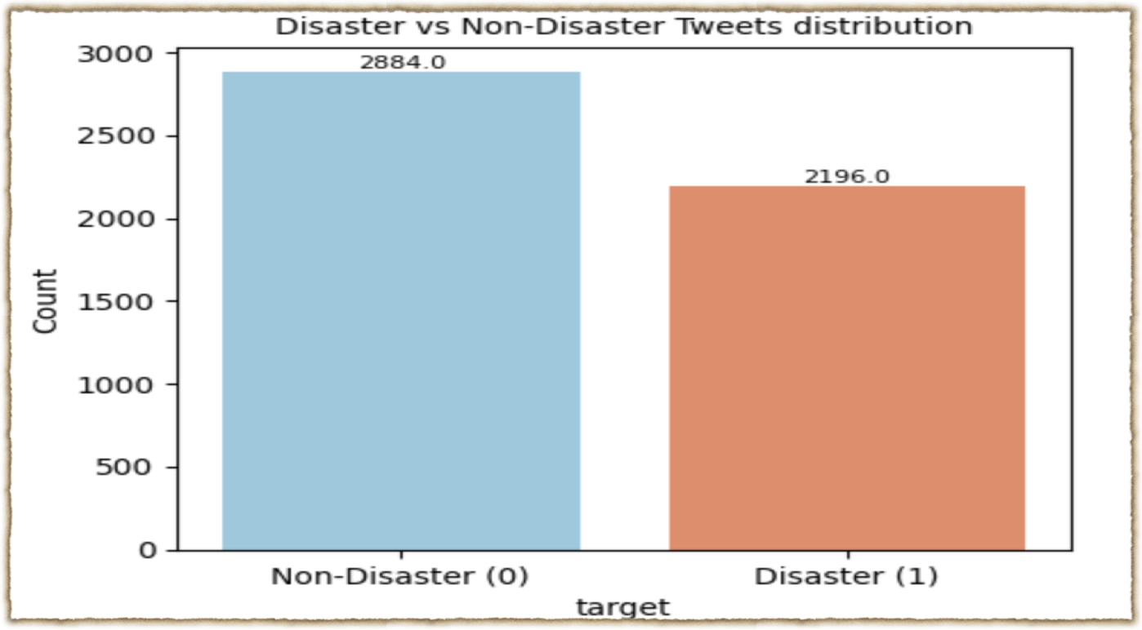
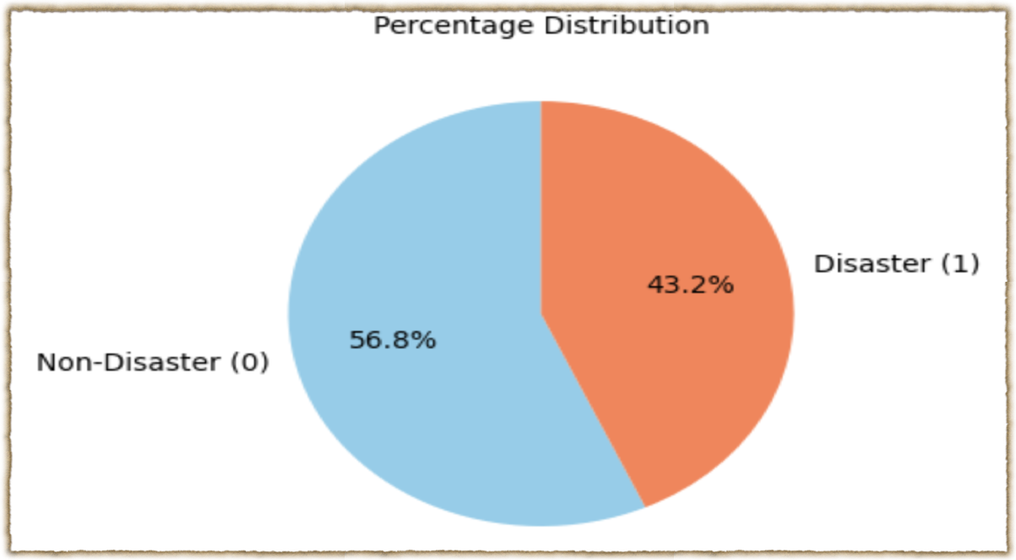
Tweet Distribution in Dataset: Non-disaster tweets: 2884 (56.77%) Disaster tweets: 2196 (43.23%)
Interpretation: The dataset is fairly balanced after dropping nulls, but still slightly more non-disaster tweets. Balanced datasets are good → reduces the risk of bias during model training.

Slide 5
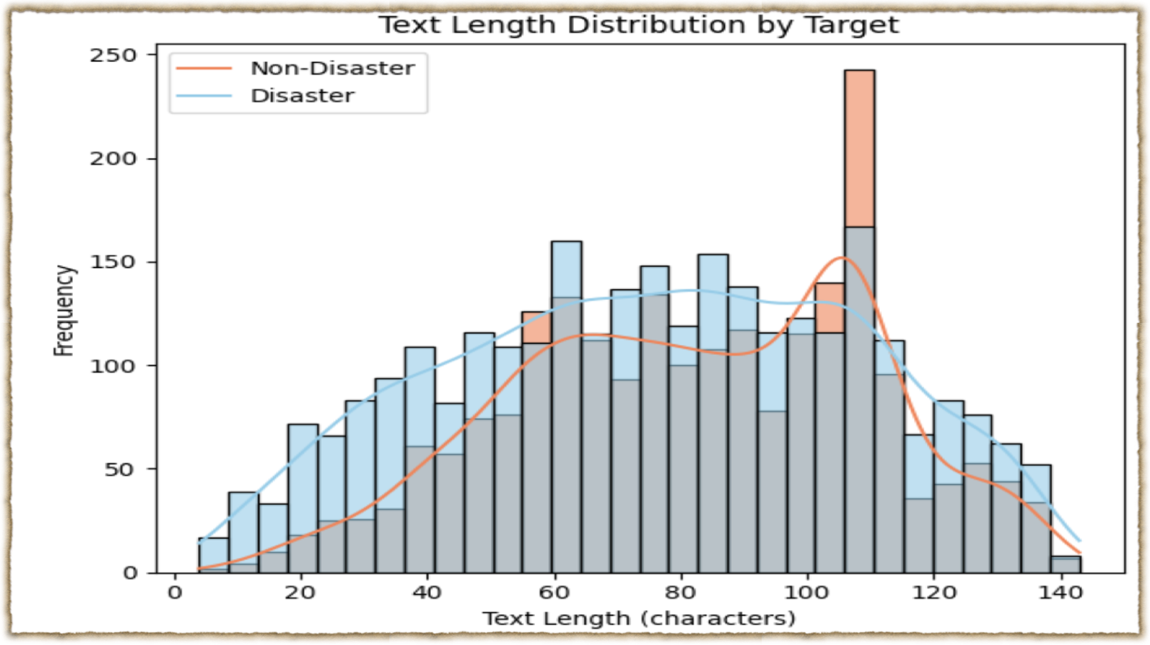
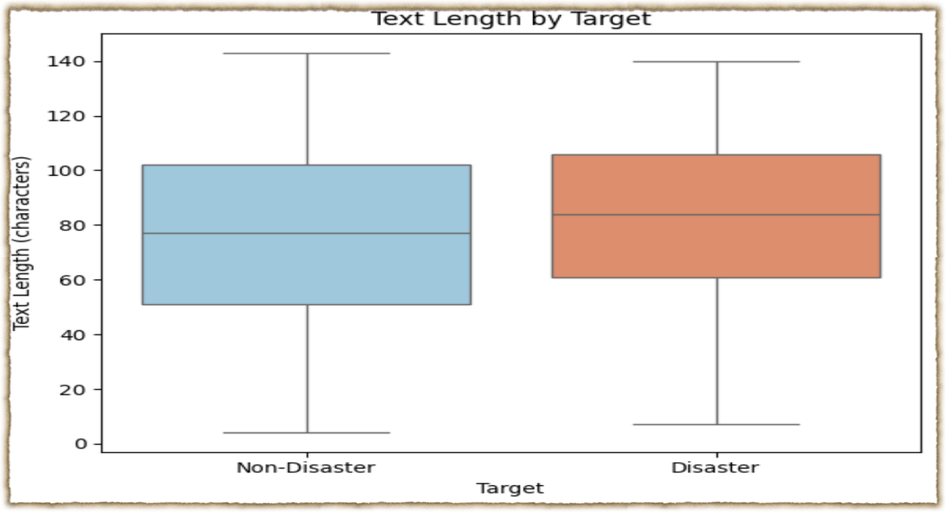
Text length analysis
Tweets are short texts typically under 140 characters.This confirms that NLP techniques for short text (like embeddings, LSTMs, transformers) are suitable.
Distribution looks natural: some very short tweets, some detailed ones, but most hover around 14 words / 80 characters. Useful for deciding padding length when tokenizing (e.g., max 30 words). Conclusion:
Average text length for non-disaster tweets: 75.80 characters.
Average text length for disaster tweets: 82.33 characters.

Slide 6
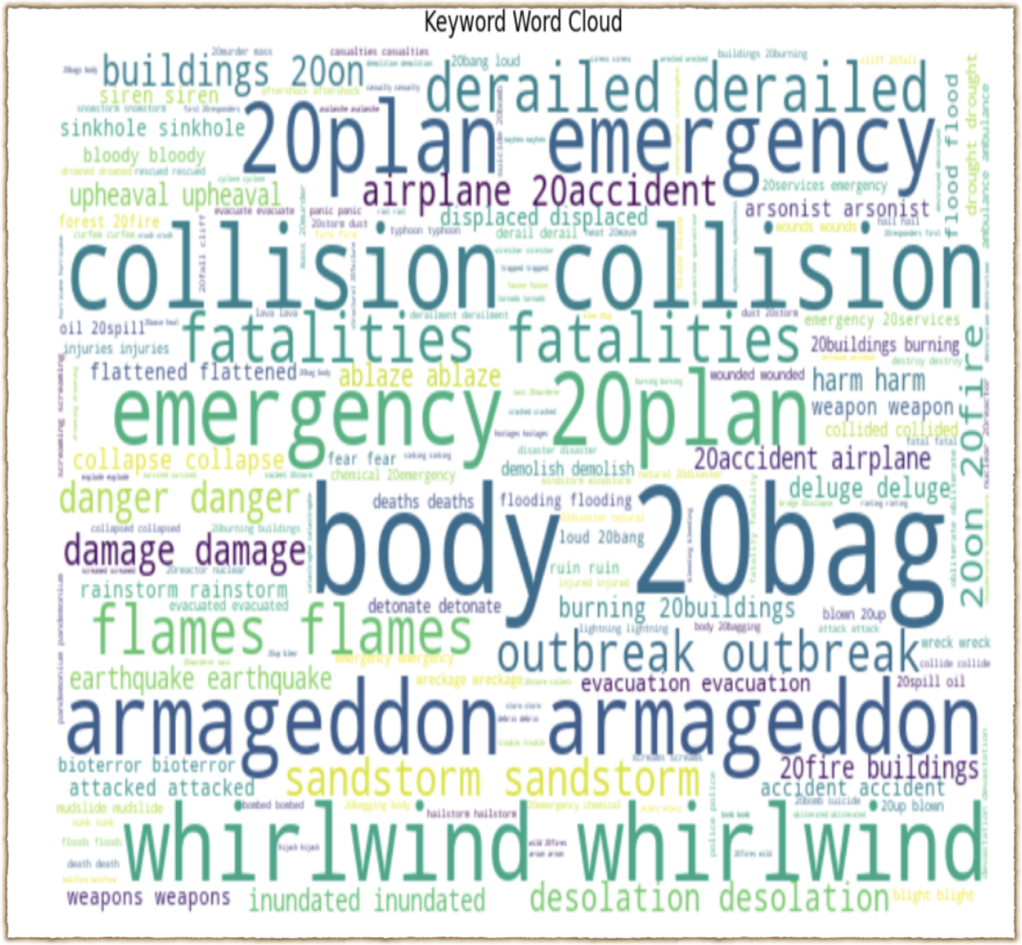
A WordCloud visually represents text data, with word sizes proportional to their frequency or importance, helping quickly identify the most common or significant terms for text analysis, sentiment insights, and feature exploration.

Slide 7
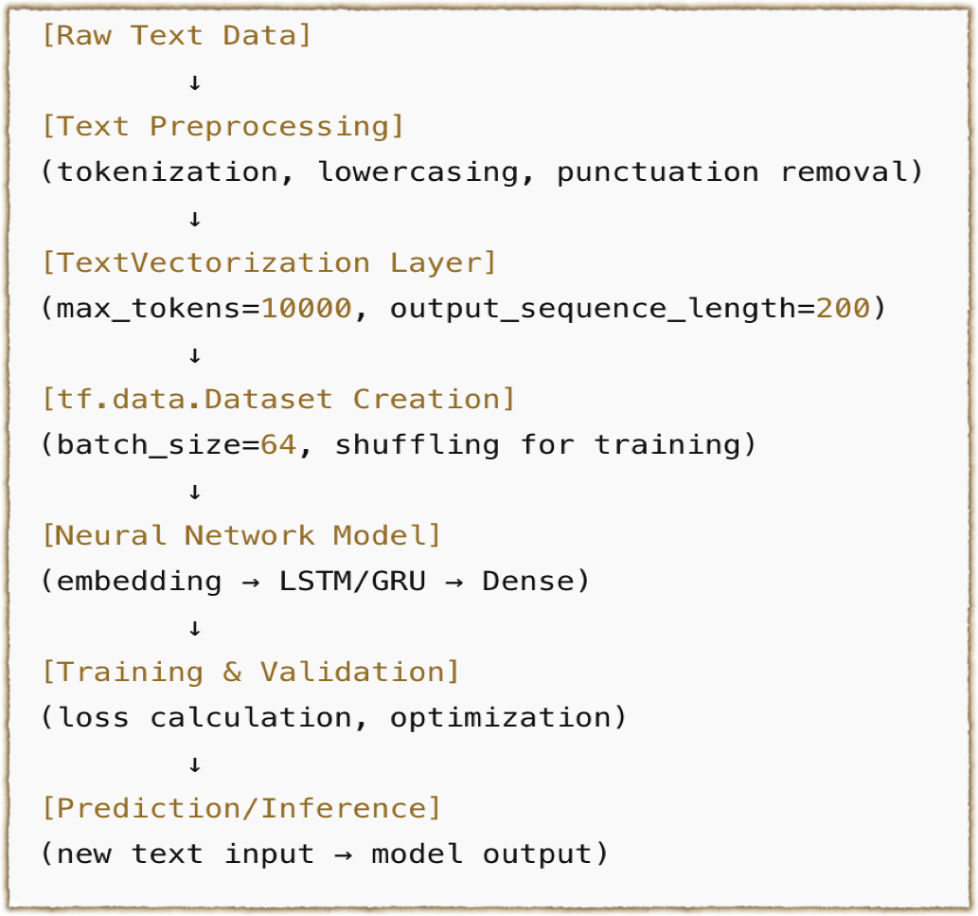
Model Architecture (Tweet Classification)
TextVectorization: Converts raw tweets into sequences of integers.
Embedding Layer: Maps each word into a 300-dimensional vector.
Bidirectional LSTM (64 units): Reads the tweet both forward and backward.
Global Max Pooling: Keeps the most important features across the sequence also reduces complexity.
Dense Layers (128 → 64 → 32 units): Fully connected layers with ReLU activation.
Output Layer: Sigmoid activation → outputs probability (0 = Non-Disaster, 1 = Disaster).

Slide 8
Model Summary
The model learned effectively from the training data, achieving a high accuracy of 94.6%, showing strong capability in capturing patterns in text.
Despite a natural drop on unseen data, it still achieves a solid test accuracy of 74.7%, demonstrating good generalization for real-world inputs.
Overall, the model is robust, reliable, and ready for practical text classification tasks, with potential for further improvement through tuning or more data.
This model is ready for deployment and capable of classifying text with confidence, and offers room for further improvement through additional data.

Slide 9
Metrics Summary
Accuracy (74.74%) – Overall, the model correctly classified 74.7% of all instances.
Precision (73.09%) – When the model predicts a positive (e.g., “disaster tweet”), it is correct 73.1% of the time.
Recall (78.41%) – Out of all actual positive instances, the model correctly identifies 78.4%. This shows it captures most of the positive cases.
F1-score (75.66%) – The harmonic mean of precision and recall, giving a balanced measure of the model’s performance, especially when classes are imbalanced.

Slide 10
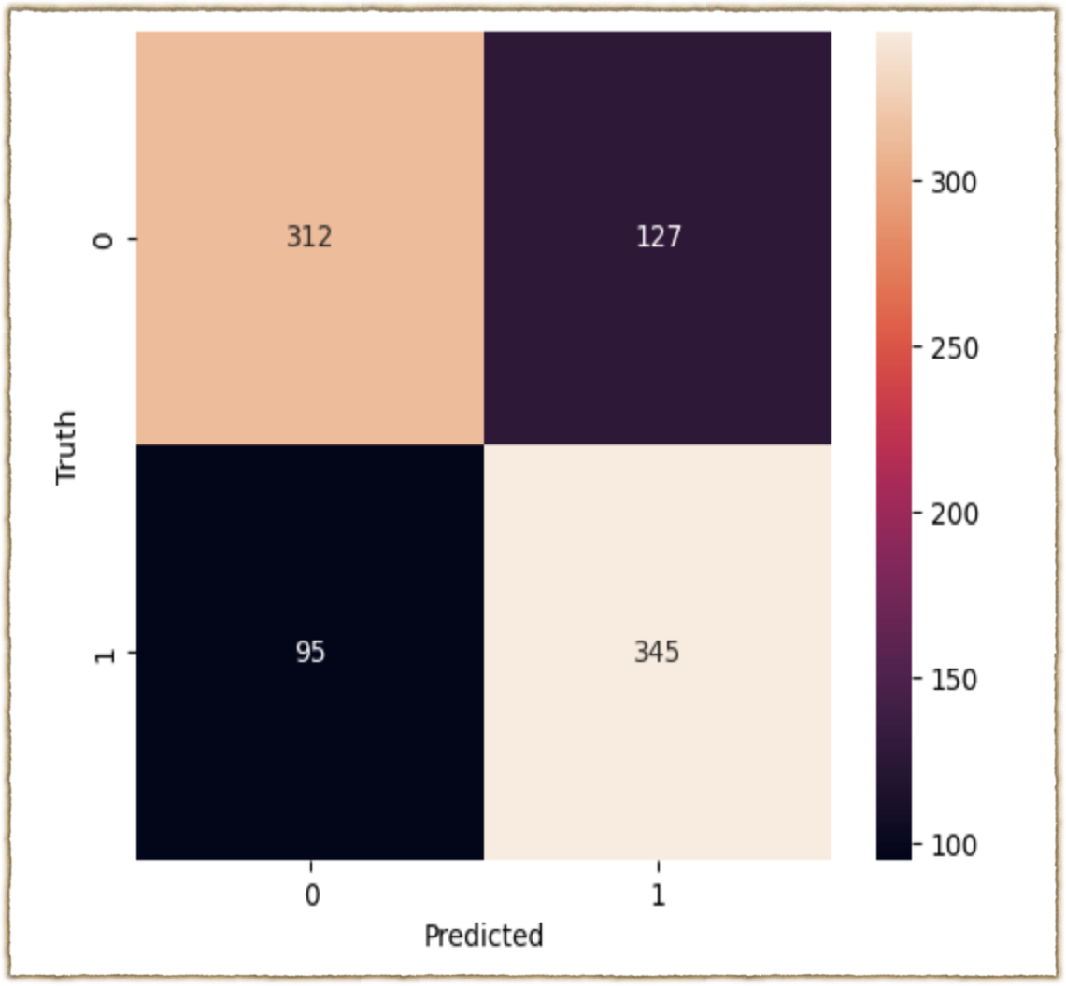
Confusion Matrix
The model demonstrates strong text classification performance with 74.7% overall accuracy, effectively distinguishing disaster and non-disaster tweets. It shows a balanced precision (73.1%) and recall (78.4%), meaning it not only predicts positives accurately but also captures most of the actual disaster tweets. The confusion matrix indicates most predictions are correct, with true positives (345) and true negatives (312) outweighing misclassifications. Overall, the model is robust, reliable, and ready for practical deployment

Slide 11
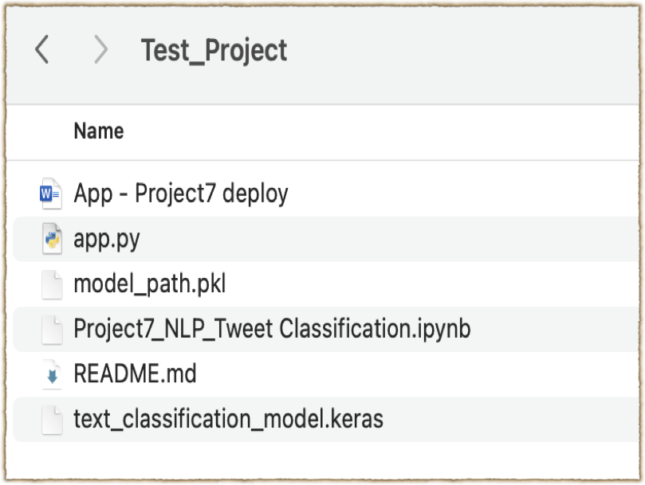
Model Deployment
The trained model is saved in Keras format to a folder so it can be reused later.To make it easy to reference, the path to this model is saved in a pickle file, allowing other scripts or apps to quickly locate it. Later, the pickle file is loaded to retrieve the model path, and the model itself is reloaded using Keras, ready to make predictions without retraining.

Slide 12
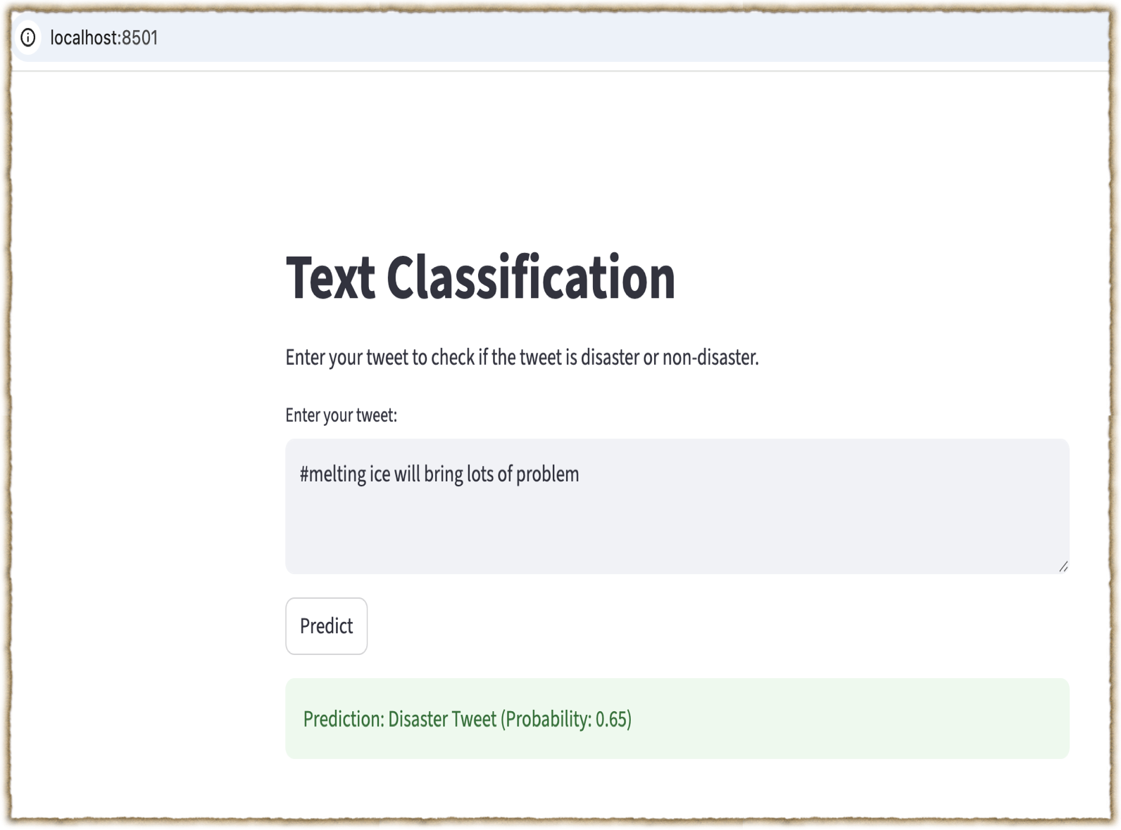
Streamlit App is now running!
Local URL: http://localhost:8503 Network URL: http://192.168.1.200:8503

Slide 13
Thank you Isha Rawat

